Slide 1
SQL Project Details
Optimizing Pizza Store Sales with Data-Driven Insights
In the competitive world of pizza sales, understanding and leveraging data is essential for driving growth and maximizing revenue. In this project, we have been provided with sales data from a pizza store, and our goal is to use SQL to tackle key challenges identified in this data. By analyzing these sales figures, we aim to uncover valuable insights, streamline operations, and enhance strategies to meet customer demands more effectively. Our mission is to transform raw data into actionable insights that will benefit all stakeholders involved, from management and sales teams to financial planners and customers. Join us on this journey to unlock the full potential of this sales data and help drive business success.

Slide 2
Problem Statement and Solution Overview
Problem Statement: The pizza store is facing several challenges that hinder its potential growth and revenue generation. These challenges include:
Inefficient Order Tracking: The store lacks a streamlined method to retrieve and analyze the total number of orders placed.
Revenue Management: There's no accurate way to calculate total revenue from pizza sales, leading to difficulties in financial planning.
Product Pricing: Identifying the highest-priced pizza and understanding its impact on sales is not straightforward.
Customer Preferences: The store does not have a clear understanding of which pizza sizes are most commonly ordered.
Category Analysis: Insight into the quantity of each pizza category ordered and their distribution is missing.

Slide 3
Proposed Solutions:
Order Tracking Enhancement: By executing specific SQL queries, we can retrieve the total number of orders placed, providing a clear view of sales volume and helping to track business growth.
Accurate Revenue Calculation: Using SQL, we can accurately calculate the total revenue generated from pizza sales. This will help in financial planning and performance assessment.
Product Pricing Insight: Identifying the highest-priced pizza through SQL queries will allow us to analyze its sales impact and pricing strategy.
Customer Preference Analysis: SQL queries will help identify the most common pizza size ordered, allowing us to tailor our offerings to customer preferences.
Category-Wise Analysis: Joining necessary tables via SQL will reveal the total quantity of each pizza category ordered, providing into category ordered, providing insights into category performance.

Slide 4
Problems on which we are going to apply our SQL Queries:
Basic problems:
Retrieve the total number of orders placed.
Calculate the total revenue generated from pizza sales.
Identify the highest-priced pizza.
Identify the most common pizza size ordered.
List the top 5 most ordered pizza types along with their quantities.
Intermediate problems:
Join the necessary tables to find the total quantity of each pizza category ordered.
Determine the distribution of orders by hour of the day.
Join relevant tables to find the category-wise distribution of pizzas.
Group the orders by date and calculate the average number of pizzas ordered per day.
Determine the top 3 most ordered pizza types based on revenue.
Advanced problems:
Calculate the percentage contribution of each pizza type to total revenue.
Analyze the cumulative revenue generated over time.
Determine the top 3 most ordered pizza types based on revenue for each pizza category.

Slide 5

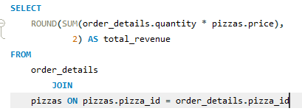
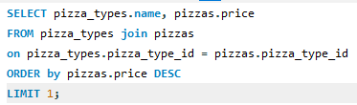
1. Retrieve the total number of orders placed
2. Calculate the total revenue generated from pizza sales
3. Identify the highest-priced pizza

Slide 6
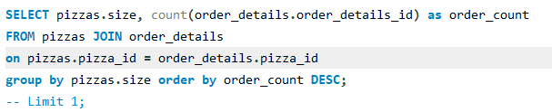
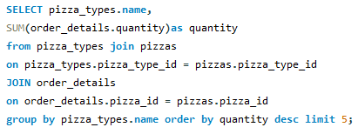
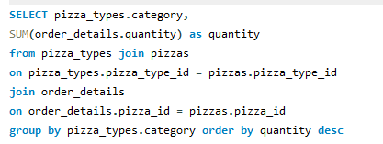
4. Identify the most common pizza size ordered.
5. List the top 5 most ordered pizza types along with their quantities.
6. Join the necessary tables to find the total quantity of each pizza category ordered

Slide 7


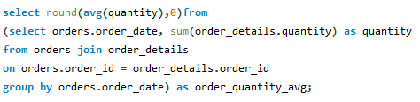
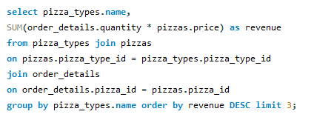
7. Determine the distribution of orders by hour of the day.
8. Join relevant tables to find the category-wise distribution of pizzas.
9. Group the orders by date and calculate the average number of pizzas ordered per day
10. Determine the top 3 most ordered pizza types based on revenue

Slide 8
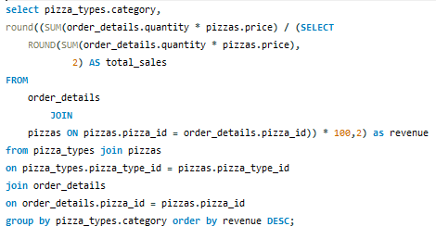
11. Calculate the percentage contribution of each pizza type to total revenue

Slide 9
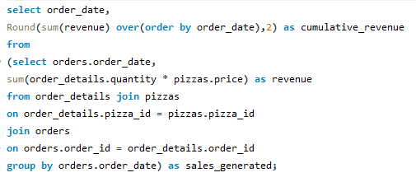
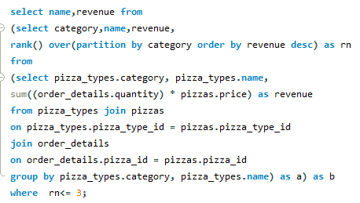
12. Analyze the cumulative revenue generated over time
13. Determine the top 3 most ordered pizza types based on revenue for each pizza category

